Slide 1

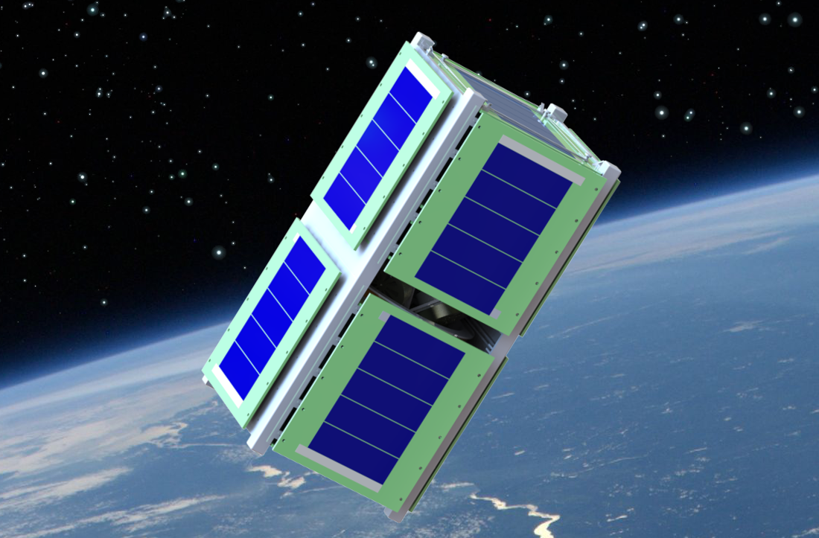
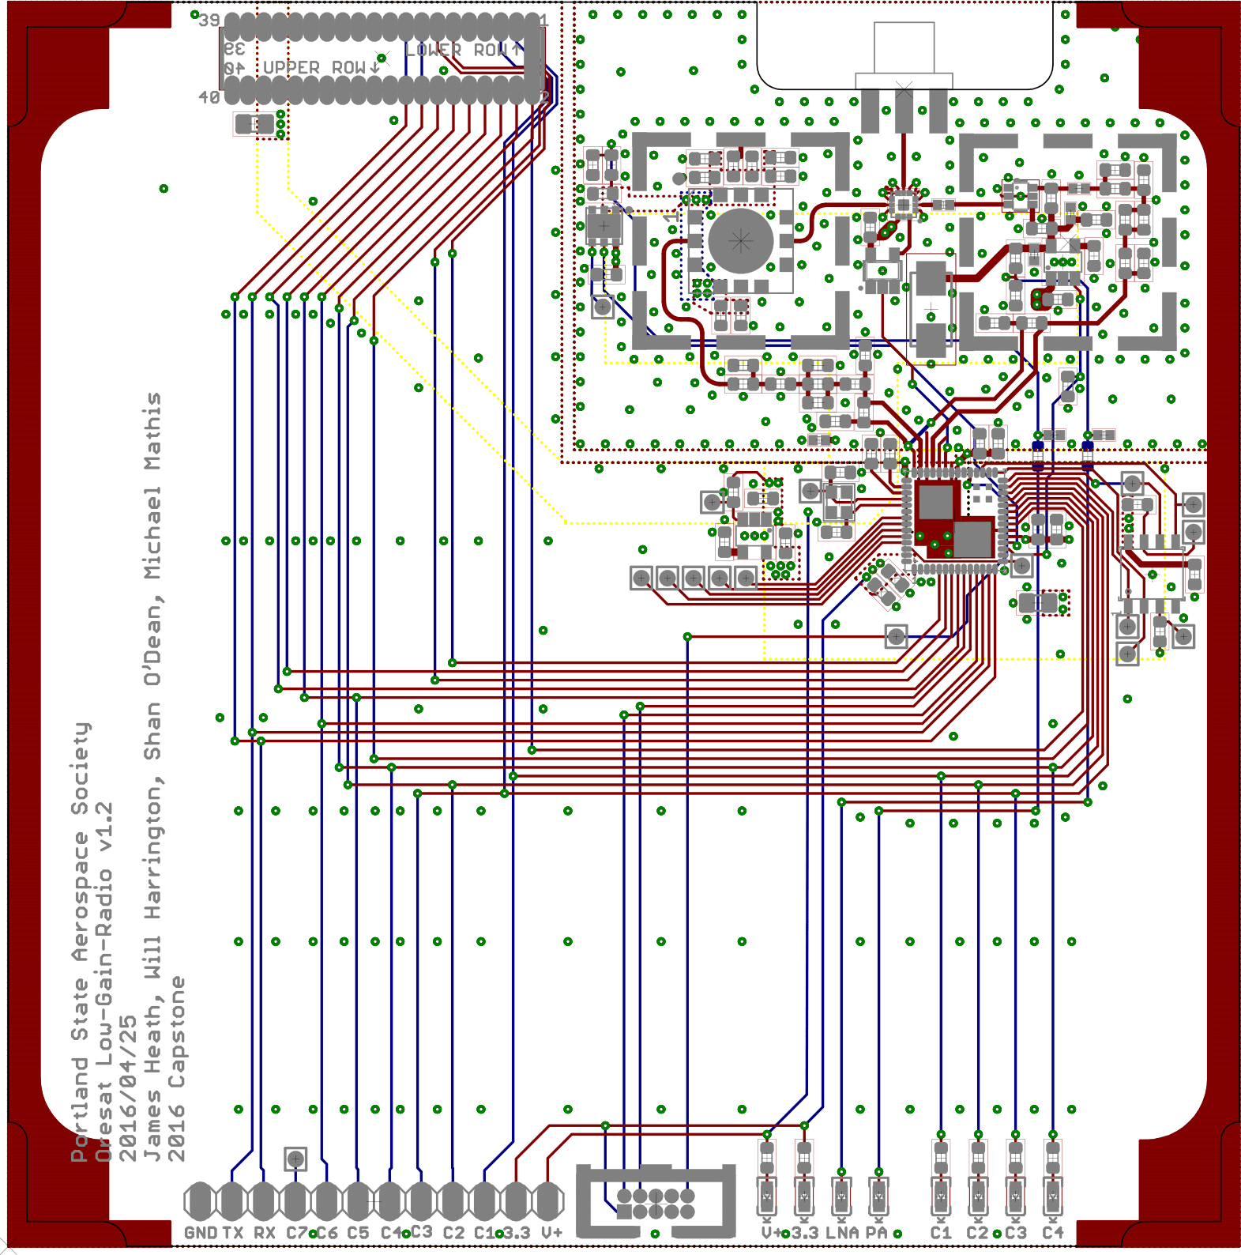
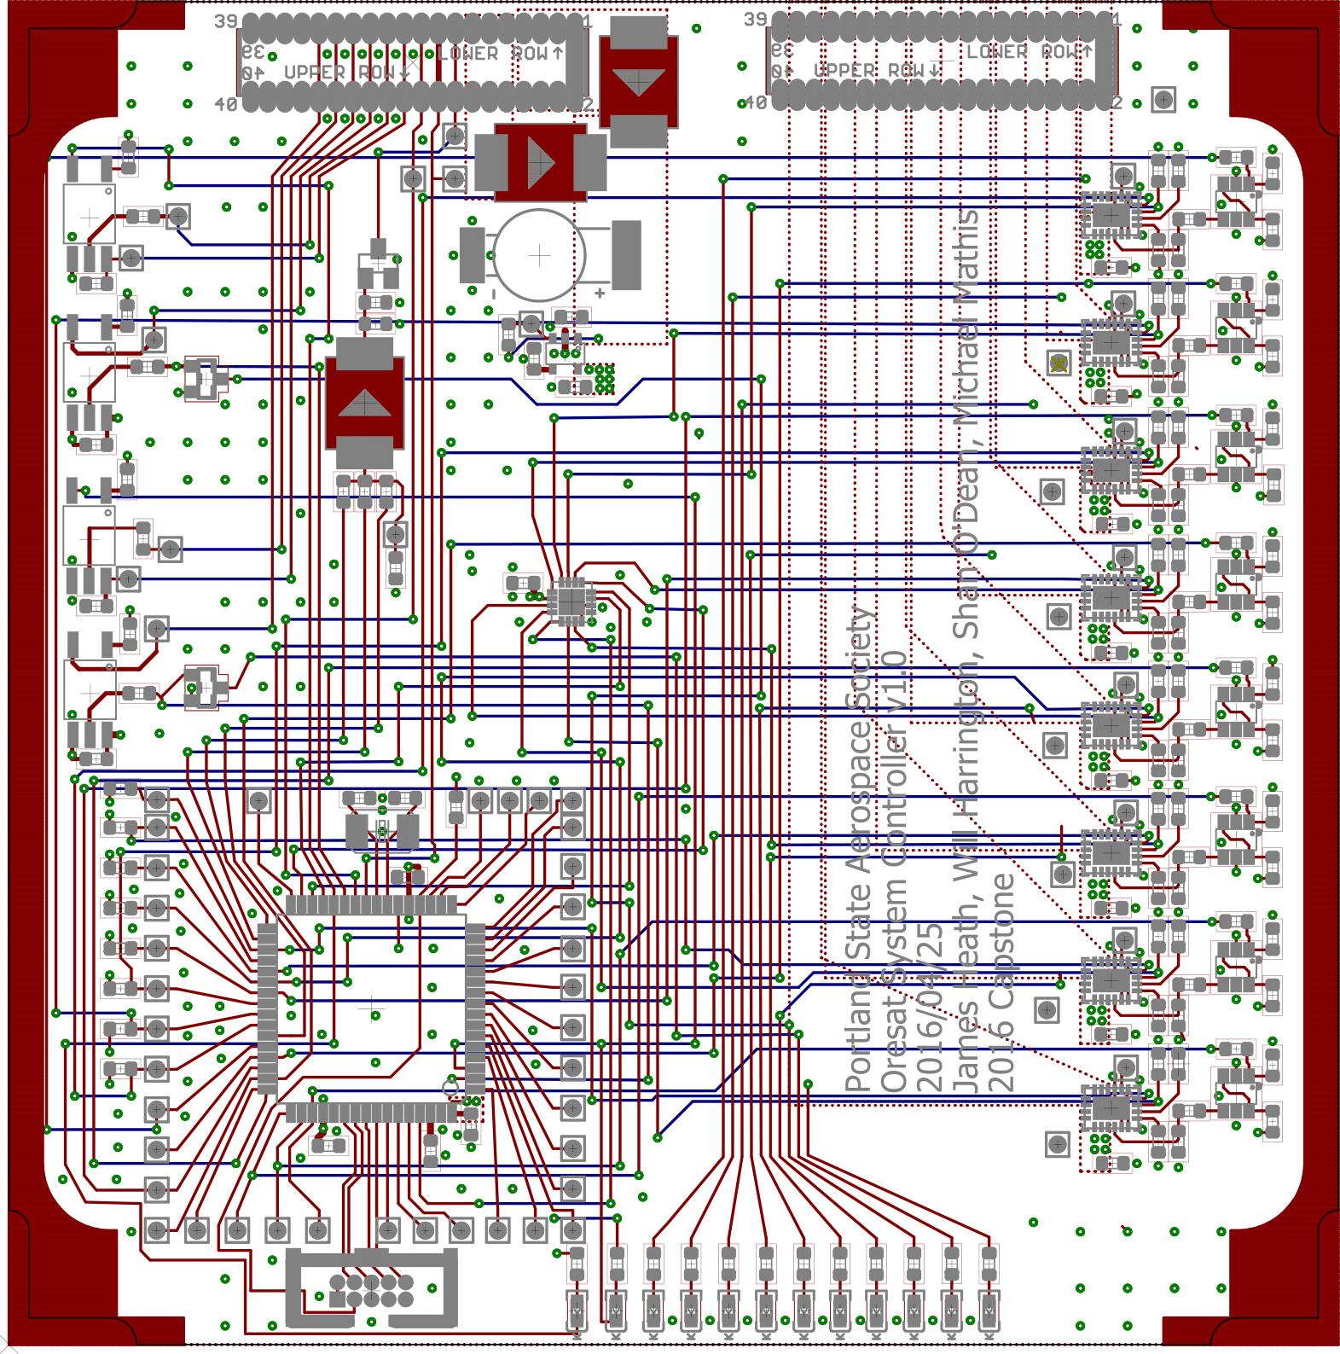
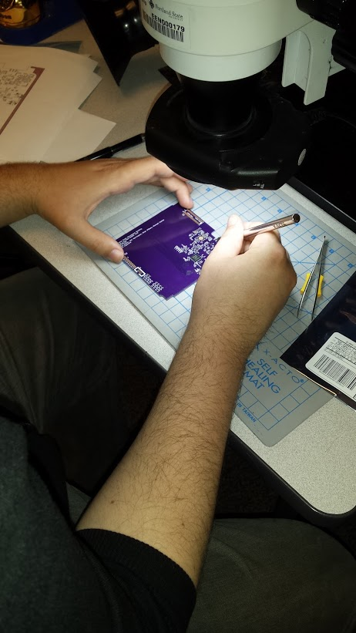
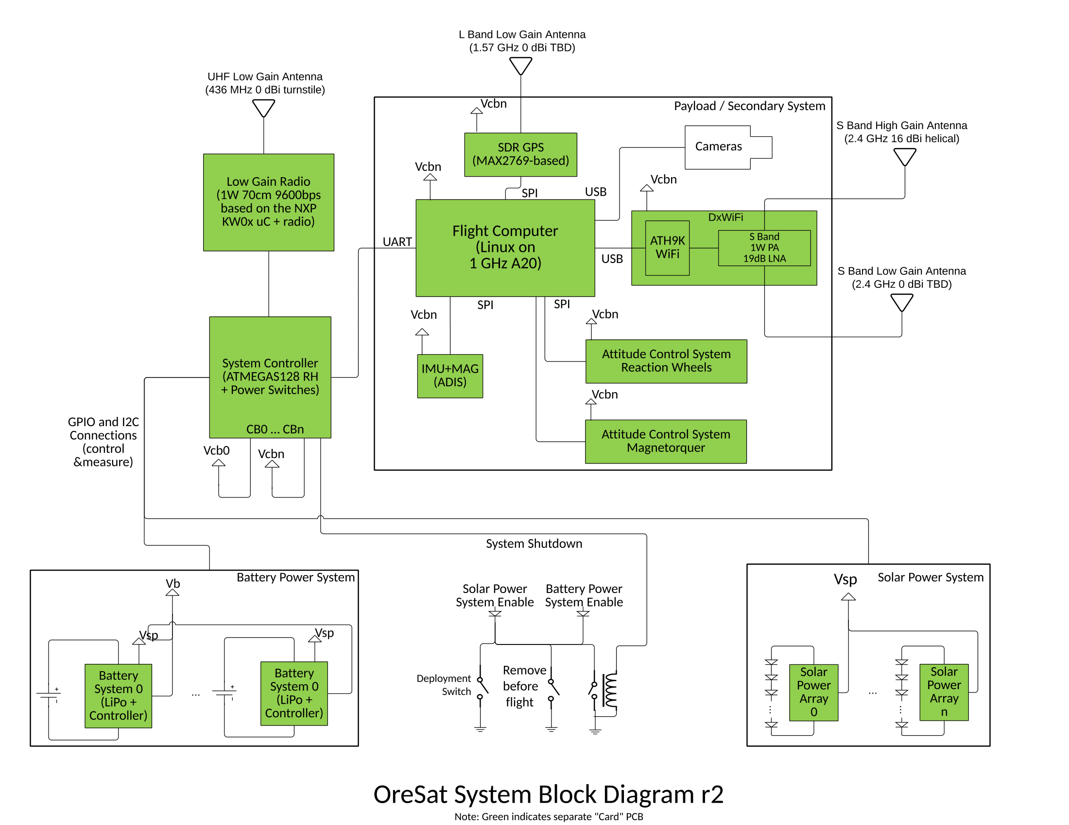
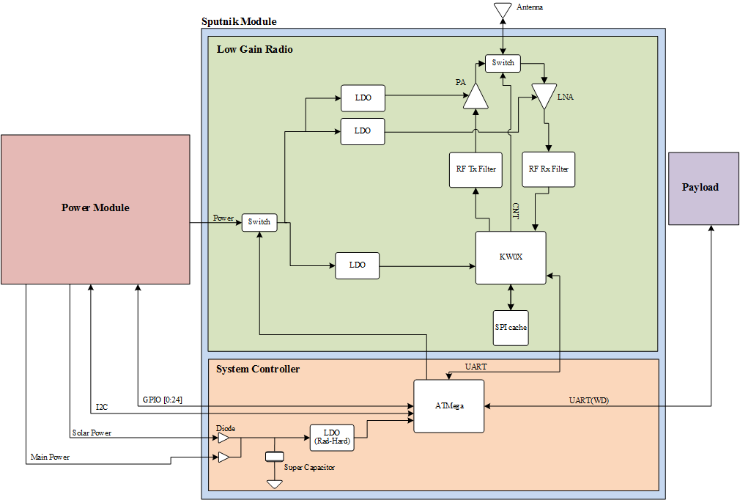
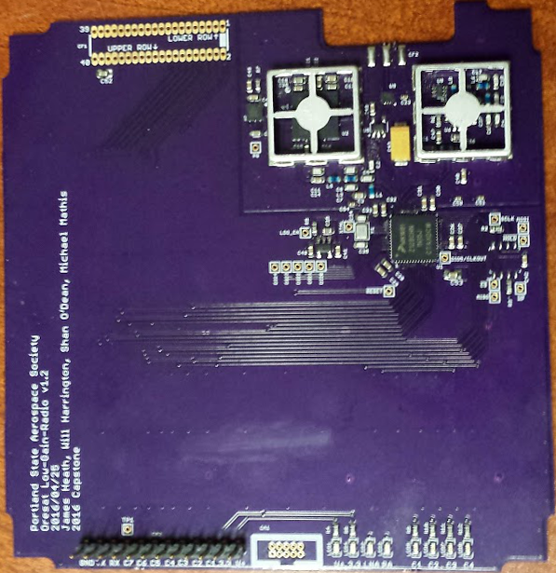
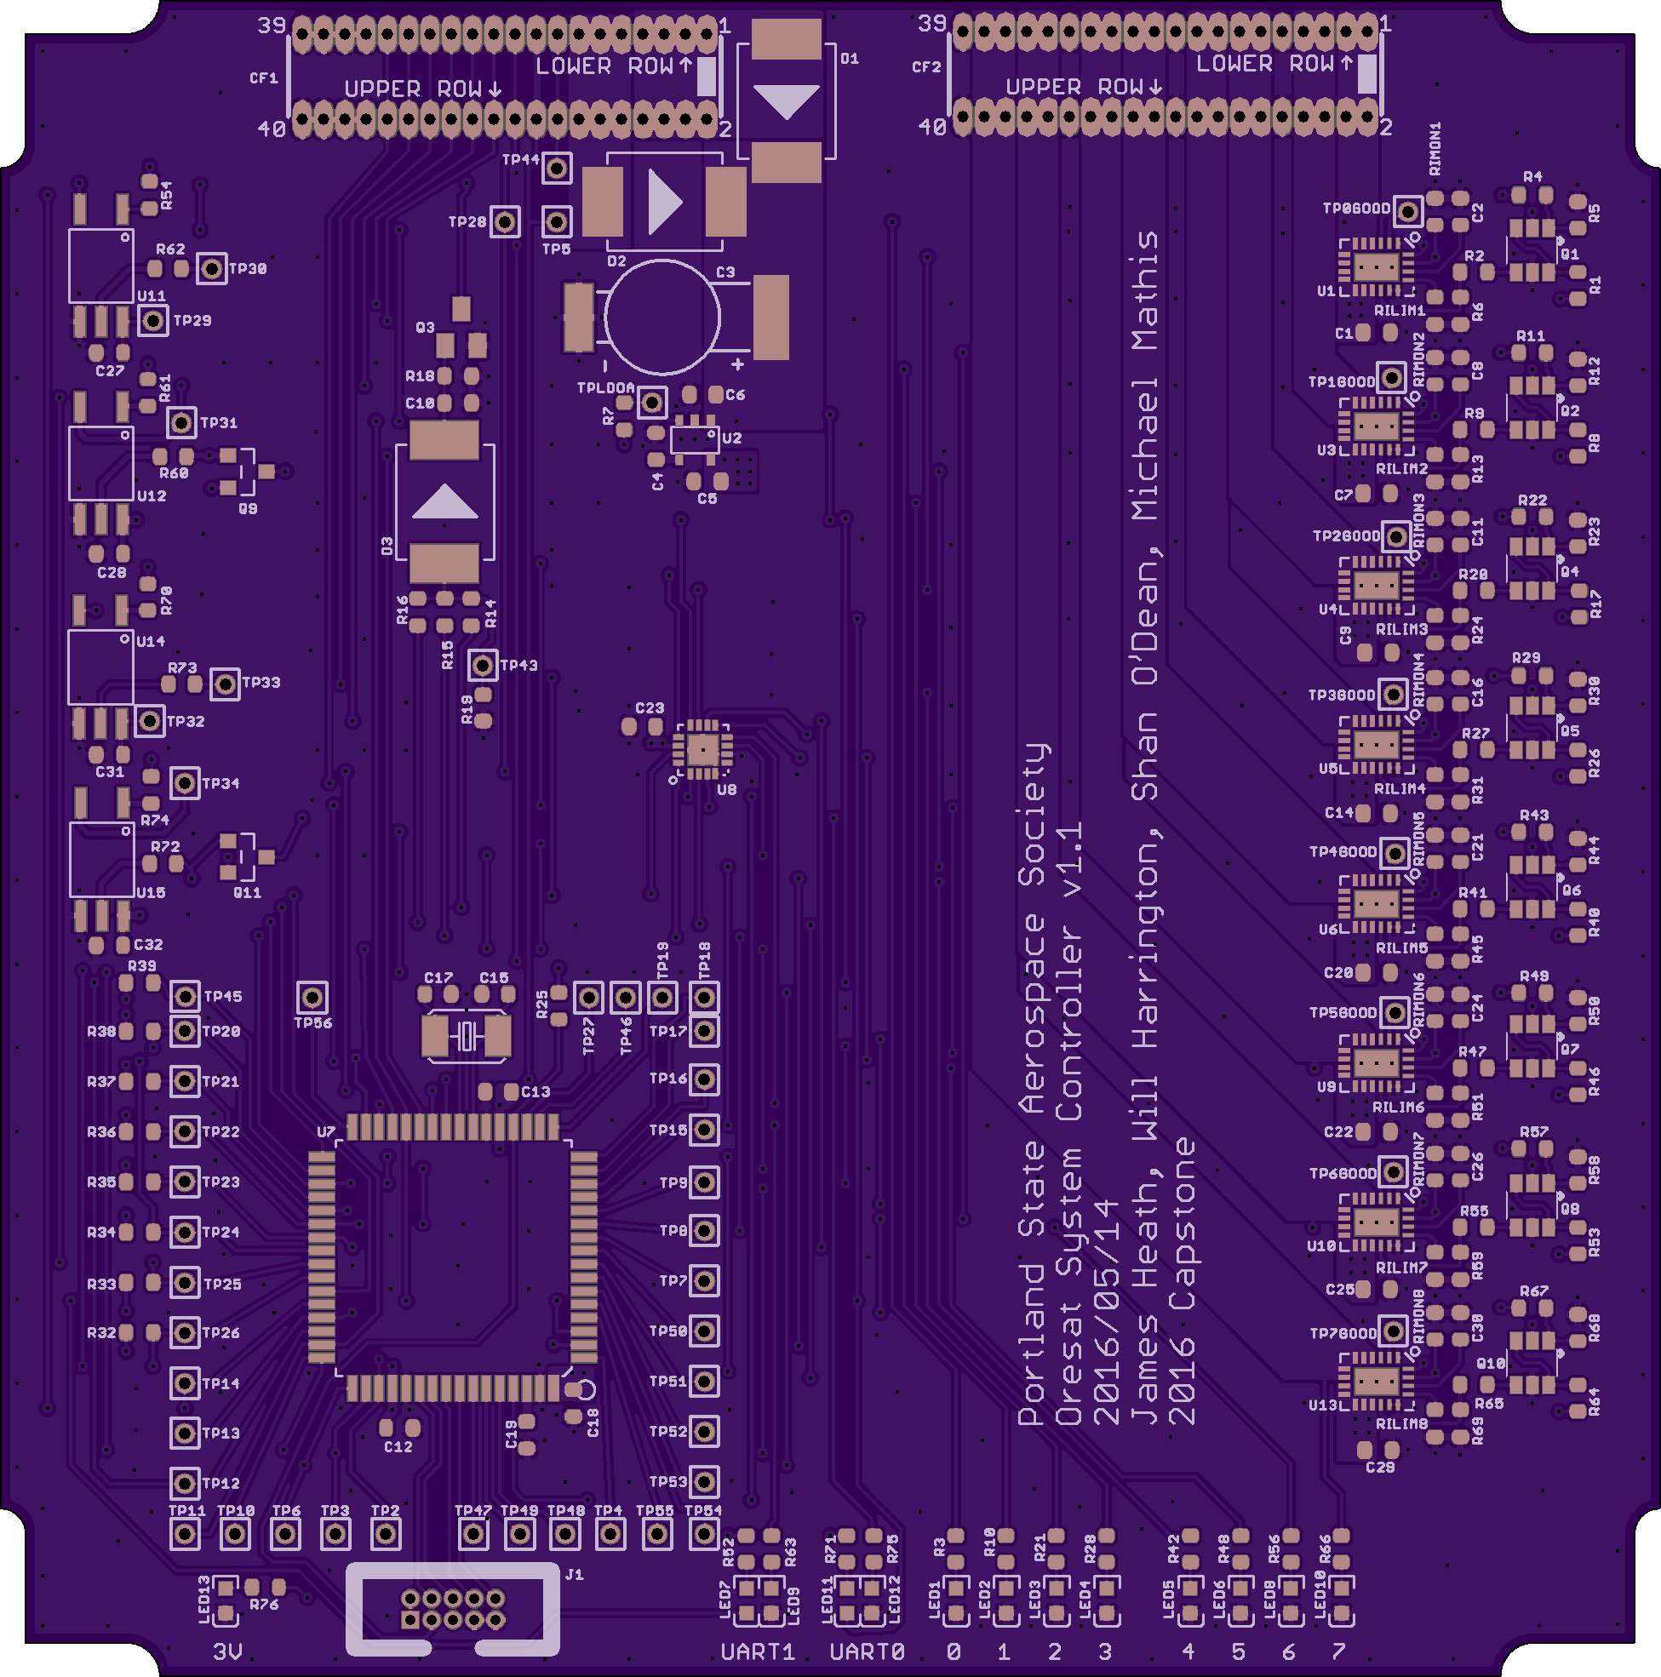

CubeSat Command Control
and Communications System
Project Team:
Will Harrington
Jake Heath
Michael Mathis
Shan Quinney
Special Thanks to:
Andrew Greenberg Theo Hill
Glenn Dr. Teuscher
PSAS The LID
Introduction
Development
The Portland State Aerospace Society (PSAS) is the lead on the Oregon Small Satellite Project's "OreSat" nanosatellite. OreSat is a CubeSat form-factor nanosatellite designed for a low-earth orbit of 400 km.
OreSat requires a robust, long-range command, control, and communication (C3) system to control the satellite. The system must reliably communicate to the ground over 1,400 km (at acquisition of signal) at low data rates (9600 bps) while monitoring and controlling the power system of the satellite
Jake Heath working on an LGR module
Board layouts of the LGR (left) and the SysCon (right)
Current Results
Design
Spectrum analyzer
screenshot
Picture of us doing
the 10km test
Graph showing SOMETHING HARDWAREY (left)
Picture of MEMBERS OF TEAM performing a 10km communications test (right)
Our capstone project is two modules among many included in the OreSat satellite. The system controller speaks UART and I²C to monitor the other systems
for the LGR (left) and the SysCon (right)
Pictures of the finished boards LGR (left) and SysCon (right)
Department of Electrical and Computer Engineering

